Slide 1
Primary Sources in Every Classroom
an interactive introduction
Dr. Dominic Klyve
William O. Douglas Honors College
Central Washington University

Slide 2
A personal journey
When I first began teaching, I did so in the way that I was taught:
I gave lectures!
I have long had a love of the history of mathematics
This history was included in my courses – a little bit
In 2002, I discovered the Euler Society, and soon became deeply involved in work on primary sources

Slide 3
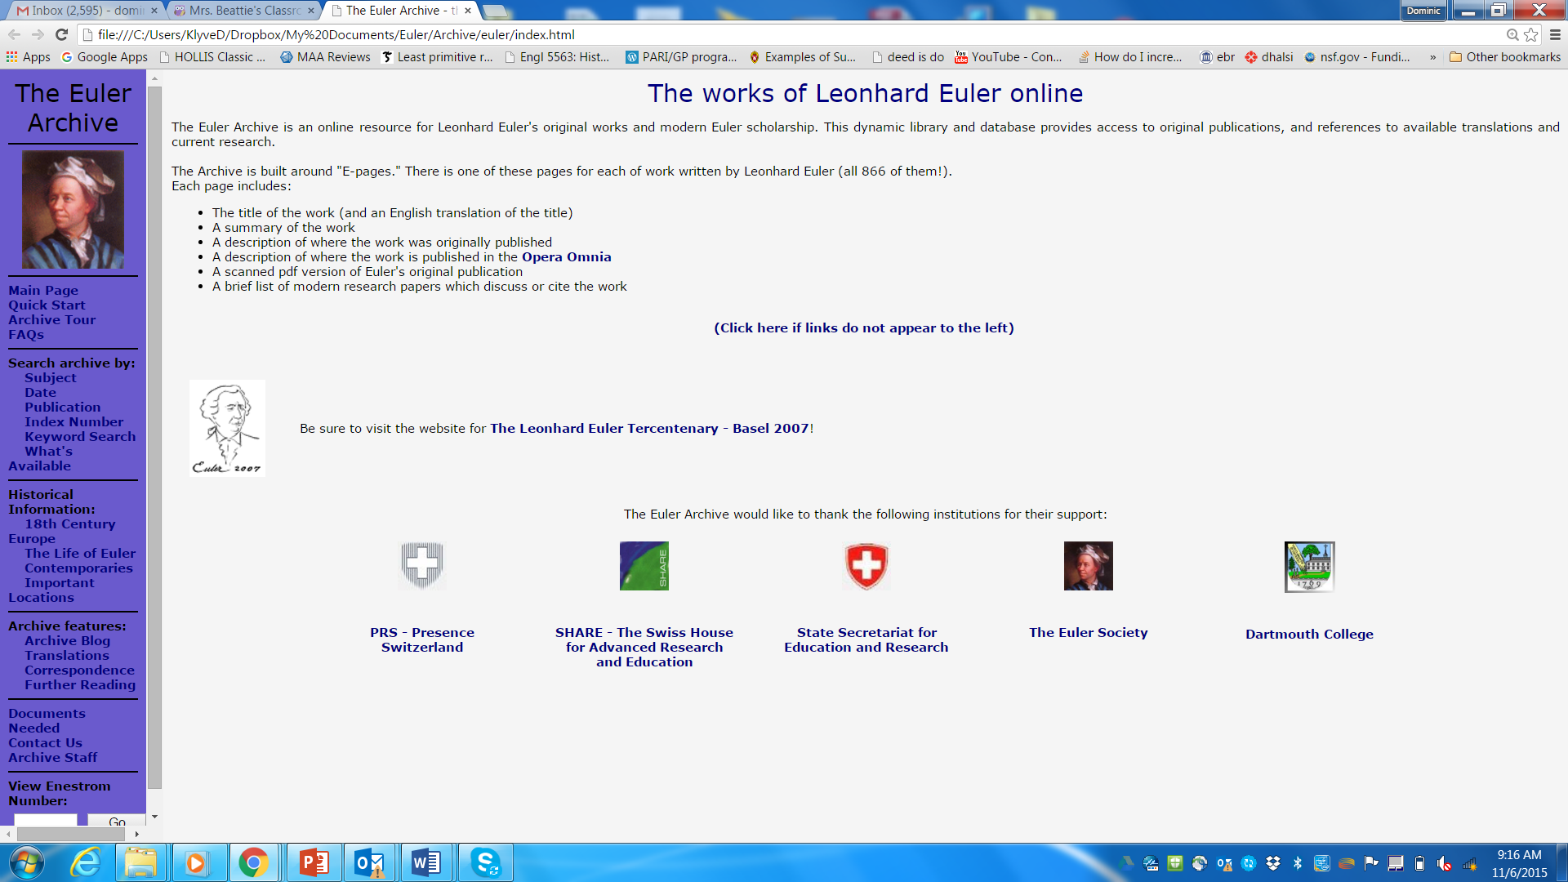
The Euler Archive

Slide 4
Teaching Discrete Math with Primary Sources
In 2006, I joined a group submitting a grant proposal to the National Science Foundation:
Learning Discrete Mathematics and Computer Science via
Primary Historical Sources
Its leaders (including David Pengelley, Jerry Lodder, and Guram Bezhanishvili) had a radical idea:
“Don’t just include some history in your math class – use the primary sources to teach the math!”
They developed several good projects, and noticed many good results.

Slide 5
Why? The goals of teaching with primary sources (From Laudenbacher, et al.)
Motivate abstract concepts.
See the creative, artistic aspect, and intellectual fascination of mathematics.
Witness mathematicians struggle, see the nature of mathematical practice and tradition, i.e., research, publication, discussion.
Sequence of sources showing a chain of attempts to solve a problem, seeing the obstacles that need clearing.
Bring students close to the experience of mathematical creation, false starts, triumphs.
See the roots of modern problems, ideas, concepts.
See the direction of mathematical development, flow, failures and successes.

Slide 6
Active goals – the next generation
The goals listed are passive (“motivate, see, witness”).
Barnett et al. have identified other goals which they incorporate into historical student projects. These include:

Slide 7
Active goals for primary source teaching
Hone students’ verbal and deductive skills through reading.
Provide practice moving from verbal descriptions of problems to precise mathematical formulations.
Promote understanding of the present-day paradigm of the subject through a historical source which requires no knowledge of that paradigm.
Promote reflection on present-day standards and paradigm of subject.
Draw attention to subtleties, which modern texts may take for granted
Encourage more authentic (vs. routine) student proof efforts through exposure to original problems in which the concepts arose.
Engender cognitive dissonance (dépaysement) when comparing a historical source with a modern textbook approach.

Slide 8
The Introduction of Guided Reading Modules
In the 2006 grant, authors developed projects based primary sources.
These projects required students to do significant exploratory and problem-solving work.
Did they accomplish their goals?

Slide 9
What we now know
Instructors who use historical modules tell us that they work well.
Student comments are very positive!

Slide 10
Student Comments
“You get to learn not just the rules and theorems, but how and why they were developed.”
“For me, being able to see how the thought processes were developed helps me understand how the actual application of those processes work. Textbooks are like inventions without instruction manuals.”
“I think historical sources help me understand the process of learning new techniques.”
“It gives you the sense of how math was formed which prepares you for how to think up new, innovative mathematics for the future.”

Slide 11
What we now know
Instructors who use historical modules tell us that they work well.
Student comments are very positive!
(Unfortunately, most existing results are anecdotal.)

Slide 12
What I believe
I believe that no field can be fully understood without historical context.
(Mathematics is no exception.)
I believe that the study of primary sources has enormous benefits – in many disciplines, this has been standard for centuries.
I believe that secondary sources are also tremendously valuable, and that our task as teachers is to find the best balance between the two.
But I can’t prove any of this. We need data!

Slide 13
A work in progress -- TRIUMPHS
Our grant effort was funded in 2015 by the National Science Foundation of the United States.
Transforming Instruction in Undergraduate Mathematics via Primary Historical Sources (TRIUMPHS)
Our three-step plan:
Step 1: Develop new projects
Step 2: Test projects in many diverse institutions
Step 3: Conduct Evaluation and Research of project effectiveness

Slide 14
Step 1: Develop new projects
Under our new grant, we have developed or will develop 20 new projects.
Content will cover material from almost every class taken by mathematics majors.

Slide 15
The Primary-Source Projects (PSPs)
A Genetic Context for Understanding the Trigonometric Functions. Trigonometric functions from Hindu, Arabic, and modern European sources.
Determinants and Their Use in Solving Systems of Equations. Linear algebra from the work of Colin Maclaurin, Gabriel Cramer, and Cauchy.
Solving a System of Linear Equations Using Elimination. Elimination methods from ancient Chinese sources, including The Nine Chapters on the Mathematical Art.
Investigating Difference Equations Using Historical Sources. Linear difference equations from the work of Abraham de Moivre [38] and Daniel Bernoulli.
Quantifying Certainty: The p-value. Statistics and hypothesis testing from the work of R.A. Fisher, K. Pearson, and Georges-Louis Leclerc, Comte de Buffon.
Games and Probability. Probability, and Waldegrave’s problem, for card games.
The Pythagorean Theorem and the Exigency of the Parallel Postulate. The parallel postulate and the Pythagorean Theorem from Book I of Euclid’s Elements.

Slide 16
The Primary-Source Projects (PSPs)
The Failure of the Parallel Postulate. Adrien-Marie Legendre’s failed proof of the parallel postulate and hyperbolic geometry from the work of Johann Bolyai and Nikolai Lobachevksy.
Topics in Abstract Algebra: Rings and Ideals. Rings and ideals from Richard Dedekind, Abraham Fraenkel, Emmy Noether, and Wolfgang Krull.
Primes, Divisibility, and Factoring. Primality, divisibility, and factorization of integers from the writings of Euclid, Pierre de Fermat, and Euler.
The Pell Equation in Indian Mathematics. The Pell equation from Sanskrit sources and in the work of Joseph-Louis Lagrange.
The Greatest Common Divisor. Finding the greatest common divisor of two positive integers, from the ancient Chinese text The Nine Chapters on the Mathematical Art.
Determining Primality. Primality testing, as found in the work of Euclid, Euler, Gauss, and others.
Proofs of the Intermediate Value Theorem by Cauchy and Bolzano. Contrasting statements and proofs of the intermediate value theorem.

Slide 17
The Primary-Source Projects (PSPs)
Rigorous Debates over Debatable Rigor in Analysis. Issues of continuity and differentiability of functions, from the works of Darboux, Peano, Houël, and Jordan.
The Origins of Complex Numbers. Development of the complex numbers, from the work of Rafael Bombelli, Wessel, Argand, Gauss, and Cauchy.
Nearness Without Distance: Three Approaches. Point-set topology and three notions of the “nearness of points,” from the work of Cantor, Hausdorff, and Kuratowski.
Connectedness—its Evolution and Applications. Ideas of the continuum, from the work of Cantor, Jordan, Schoenflies, and Lennes, which led to the study of connectedness by Knaster and Kuratowski.
Construction of the Figurate Numbers. Figurate numbers, patterns in their values, and relations to probability, from the work of Nicomachus and Fermat.
Pascal’s Triangle and Mathematical Induction. Pascal’s Triangle and Mathematical Induction, centered on excerpts from the writings of Blaise Pascal.

Slide 18
A new idea: the mini-PSP
One barrier to faculty committing to use a project is time.
Instructors worry that a project will take too much class time.
To encourage them to try a project for the first time, we are writing “mini-Projects”, designed to take <1 – 1.5 days of class time.

Slide 19
Step 2: Test projects in many diverse institutions
We know that the author of a project can effectively use the project in a classroom.
A big question: can others?
After development, we want many different teachers and professors to test our projects (site testers).

Slide 20
Site testers
Fifty faculty at 30 institutions have already agreed to serve as site testers.
They will all collect data from their class, write about and evaluate their experience, and receive a small stipend.
This spring 12 faculty members at 12 American universities will test projects.
We will recruit more through a series of workshops aimed at training people in the use of projects.
International testing could be fun, too….

Slide 21
Step 3: Conduct Evaluation and Research
Research on whether these projects are effective is crucial.
This is a big part of our grant effort.
We are very interested in the impact of the use of PSPs on changing undergraduate students’ perceptions of the nature of mathematics over time.
We also wish to develop and improve students’ ability to create and articulate mathematical arguments.

Slide 22
Evaluation Questions (students)
As a result of engaging with PSPs, what changes do students report in:
their articulation of the challenges and benefits of learning from primary sources,
their understanding of the nature of mathematics,
their attitudes and beliefs about doing and learning mathematics, and
their likelihood of more formal study of mathematics?
How many students completing at least one PSP go on to complete:
additional course work in mathematics, and
a mathematics or mathematics education degree?

Slide 23
Evaluation Questions (faculty)
3. What faculty characteristics may predict or explain which faculty and graduate students choose to attend training workshops and to implement PSPs?
4. What elements of the workshops and ongoing support for authors and site testers are critical to the success of faculty implementation of the PSP(s) and ongoing faculty engagement in a community of like-minded practitioners?

Slide 24
Research Methods
Instruments being developed include:
Pre-PSP Surveys
Post-PSP Surveys
Student Work Artifacts
Student Retention data
Interview protocols

Slide 25
An example: Leonhard Euler's Observationes de themornate quodam Fermatiano
In 1727, Leonhard Euler wrote first his paper on number theory.
It concerns primes, divisibility, and factoring.
It contains brilliant observations, deep insight, and silly mistakes….

Slide 26
Want to know more? Interested in participating?
I'd love to hear from you!
Dominic Klyve
Central Washington University
klyved@cwu.edu

